Slide 1
Amateur Astro Engine

Slide 2
Presented By:
Hasin Ahmed
BSSE-1415
IIT,DU
Supervisor:
Dr. Sumon Ahmed
Associate Professor
IIT, DU

Slide 3
What’s the project all About?
This is an engine for amateure astronomers by using it they can learn how to track celestial objects , predict astronomical events using previous data & filter astronomical images .

Slide 4
Project motivation : Computational astronomy is a rapidly expanding field. NASA, NRAO and numerous other institutes have begun to open-source their datasets for research purposes. However, astronomical data-analysis software can be quite complex for young learners . It’s very challenging for them to understand and modify these tools for their use. In this project, I have implemented simplified algorithms to facilitate young learners' comprehension of how these systems function, enabling them to explore and learn about computational astronomy more easily.

Slide 5
Key Features:
Gradient descent
Image Stacking
Spherical coordinate Calculator

Slide 6
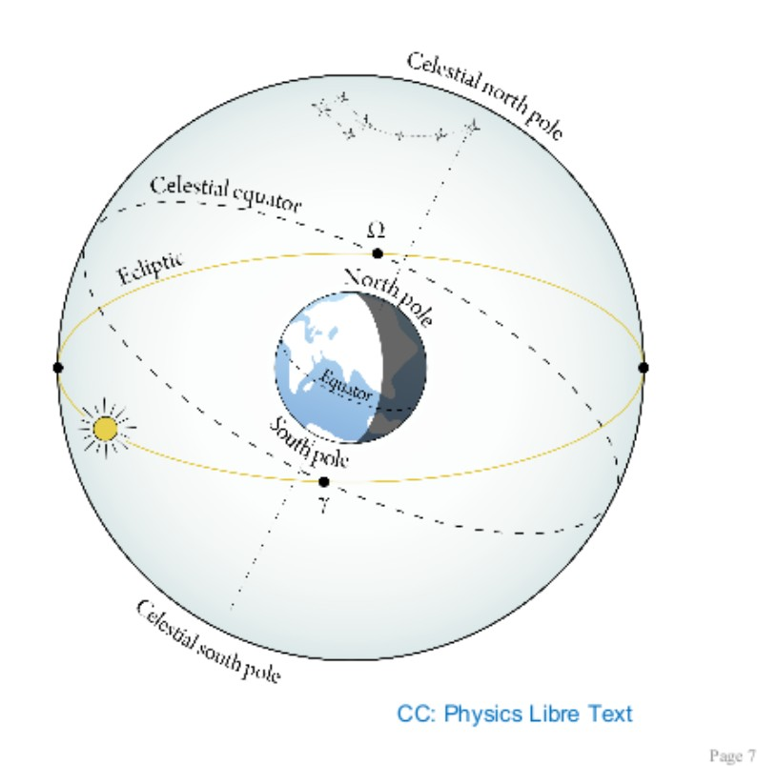
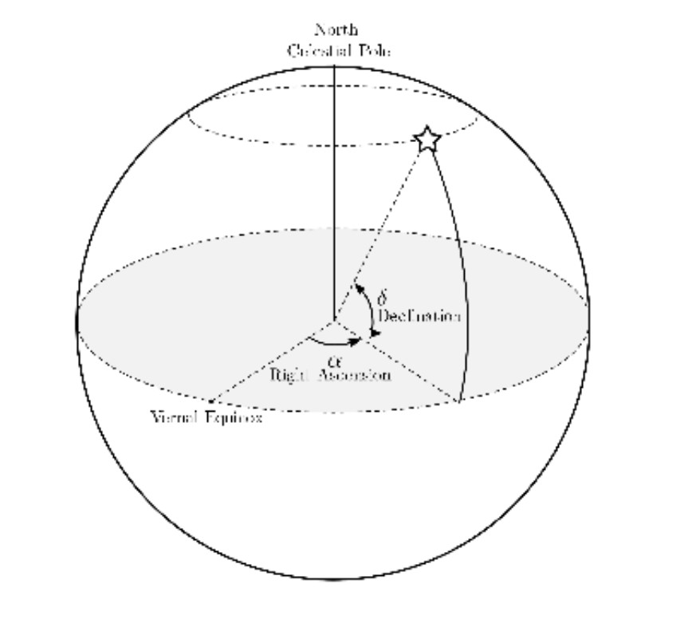
Coordinate Calculations in Celestial-sphere:

Slide 7
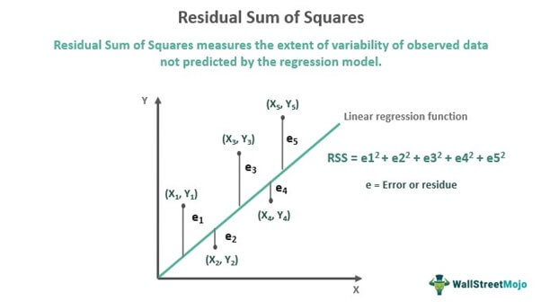
Regression:A regression is a statistical technique that relates a dependent variable to one or more independent (explanatory) variables
RSS:The residual sum of squares measures the level of variance in the error term, or residuals, of a regression model.

Slide 8
How can we get the best fit model?
By picking the coefficients of the parameters for which RSS gives the minimum value.

Slide 9
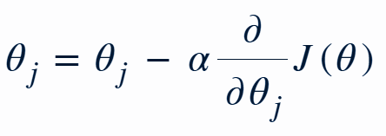
Gradient Descent:
Gradient descent is an optimization algorithm that minimizes a function by iteratively adjusting the model parameters in the direction of the steepest decrease in the function's value.

Slide 10

2D:

Slide 11
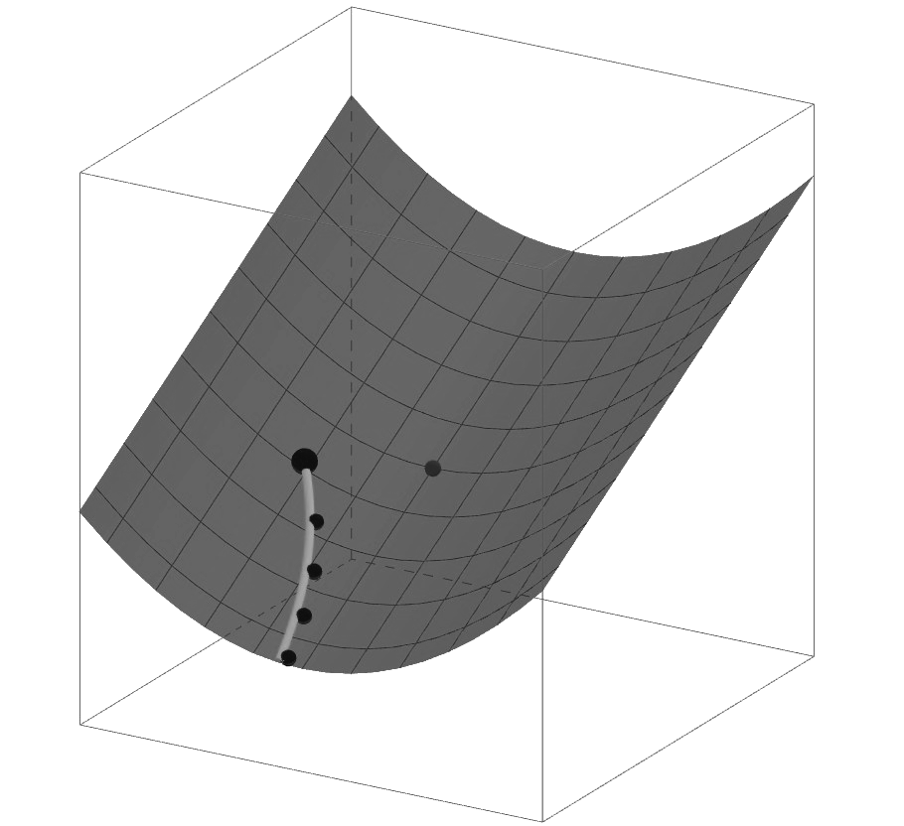
3D:

Slide 12
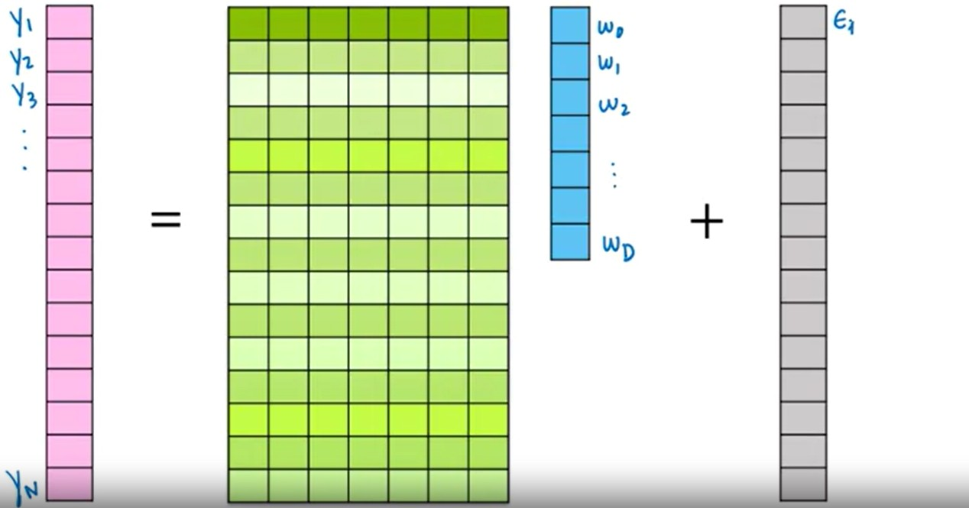
N-Dimensional:

Slide 13
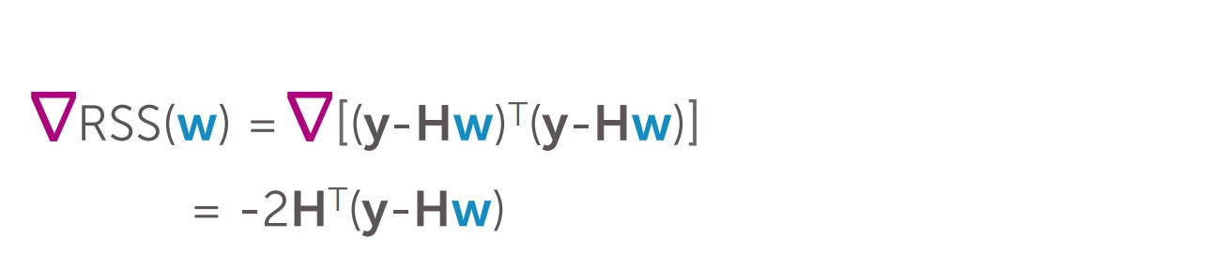
Gradient of ND matrix form model:

Slide 14
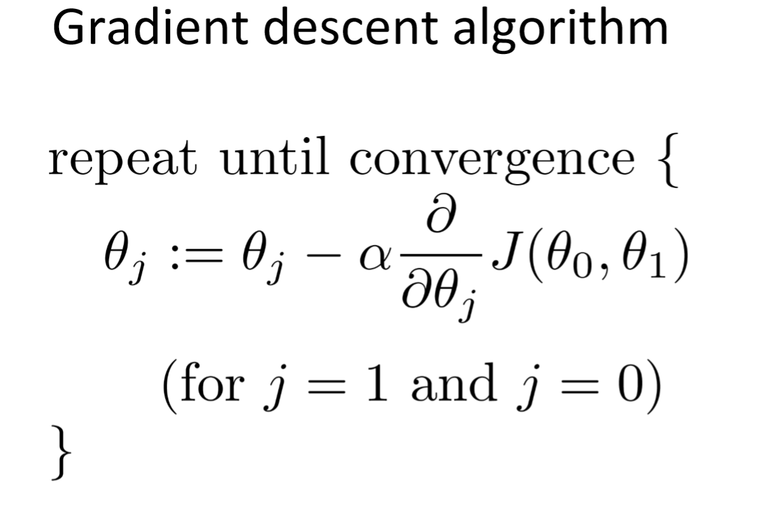
Algorithm:

Slide 15
Image Stacking: Image stacking is a technique used in astrophotography and image processing to combine multiple photos of the same subject to reduce noise, enhance details, or create long-exposure effects.

Slide 16
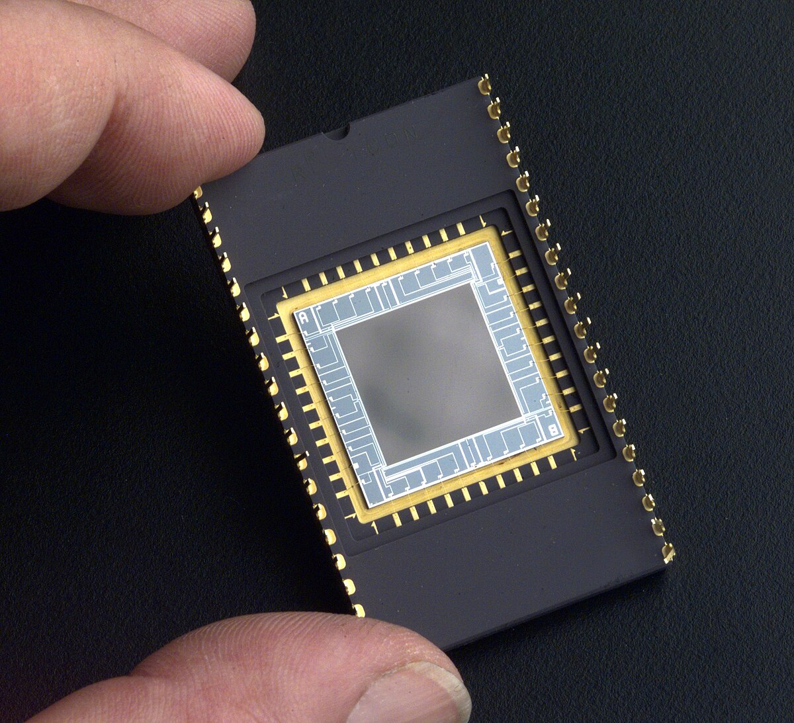
CCD:

Slide 17
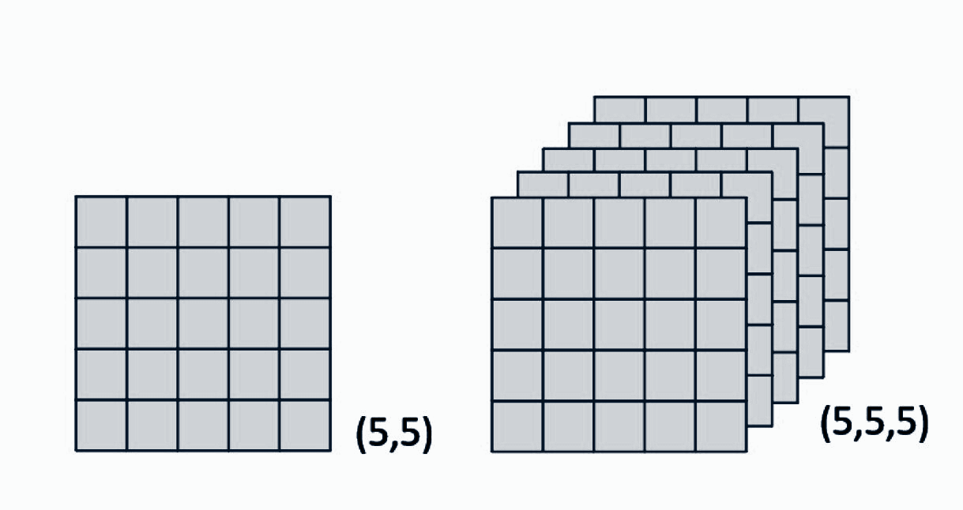
Stacking grid of 5 images:

Slide 18
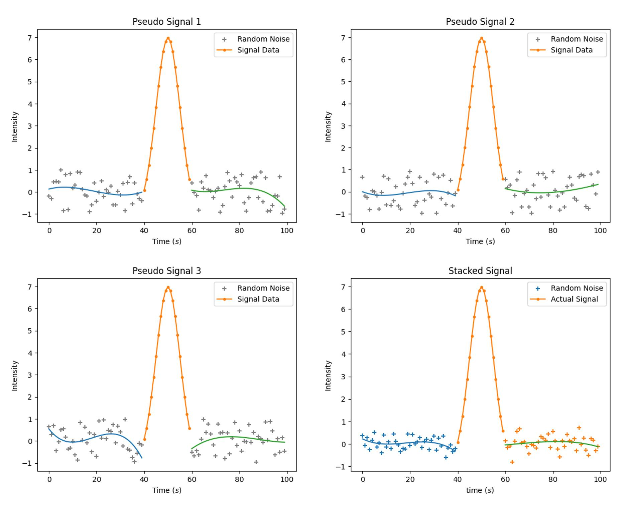
Analogy with signals:

Slide 19
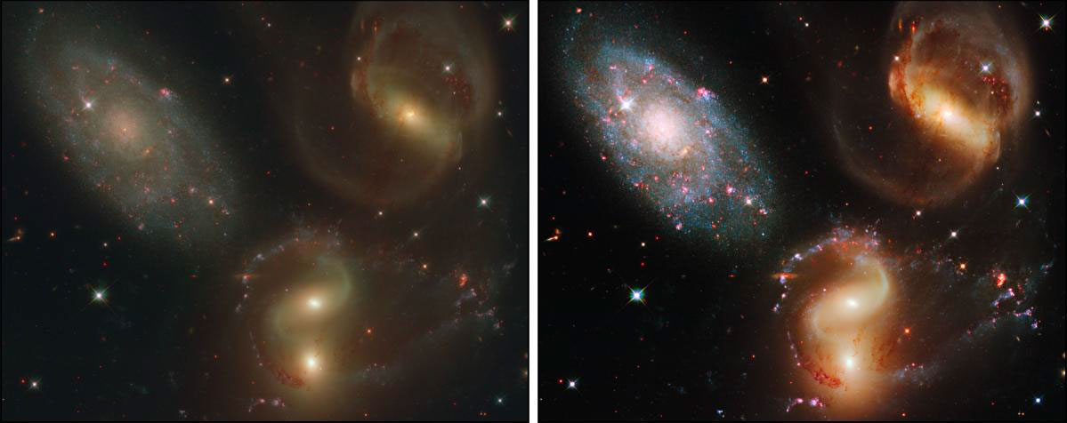
Before Stacking
After Stacking

Slide 20
Future Feature Plan:
Principal Component Analysis

Slide 21
SPL Project’s link:
https://github.com/hasin1415/SPL-01.git

Slide 22
Thank You!

